Slide 1
Encoding Categorical Data
By Owais Ahmed Khan

Slide 2
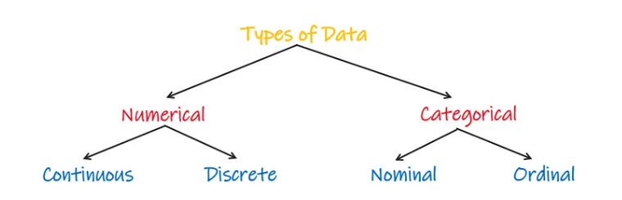

Slide 3
What Is Encoding?
Encoding categorical data is a process of converting categorical data into integer format so that the data can be provided to different models.
Categorical data will be in the form of strings or object data types. But, machine learning or deep learning algorithms can work only on numbers.

Slide 4
What is encoding?
When working on some datasets, we found that some of the features are categorical, if we pass that feature directly to our model, our model can't understand those feature variables.
We all know that machines can't understand categorical data.
Machines require all independent and dependent variables i.e. input and output features to be numeric.
This means that if our data contain a categorical variable, we must have to encode it to the numbers before we fit our data to the model.

Slide 5
What is encoding?
Models only work with numerical values.
For this reason, it is necessary to convert the categorical values of the features into numerical ones, So the machine can learn from those data and gives the right model.
This process of converting categorical data into numerical data is called Encoding.
The two most popular techniques of encoding are,
Nominal Encoding
Ordinal Encoding

Slide 6
Ordinal Encoding
We need to maintain the intrinsic order while converting ordinal data to numeric data.
Each category will be given numbers from 0 to n number of categories.
If we have 3 categories in the data, such as 'bad', 'average', and 'good', then bad will be encoded as 0, average as 1, and good as 2. So that the order is maintained.
When we train the machine learning model, it will learn the pattern with the intrinsic order giving better results.
For example: Student’s performance, Customer’s review, etc…

Slide 7
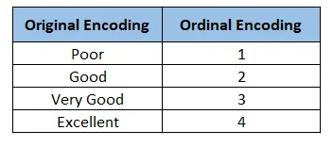

Slide 8
Ordinal Encoder
In scikit-learn, OrdinalEncoder is a class that is used to transform ordinal categorical features into integer codes.
It maps each category in each feature to a different integer.
class sklearn.preprocessing.OrdinalEncoder

Slide 9
Label Encoder
Encode target labels with value between 0 and n_classes-1.
This transformer should be used to encode target values, i.e. y, and not the input X.
class sklearn.preprocessing.LabelEncoder

Slide 10
Nominal Encoding
Nominal data will not have intrinsic order, we make use of OneHotEncoder class from sklearn to encode the nominal data.
If we start encoding categories from 0,1,2 to all the categories, then the machine learning algorithm will give importance to 2 (more than 0 and 1), which will not be true as the data is nominal and will have no intrinsic order. So, this method will not work in the case of nominal data.
Here each of the categories will be transformed into a new column and will be given values of 0 or 1 depending on the occurrence of the respective category. So, the number of features will increase after the transformation.

Slide 11
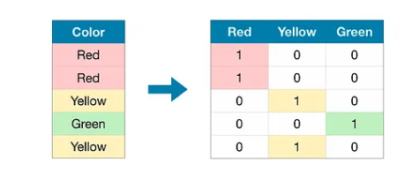

Slide 12
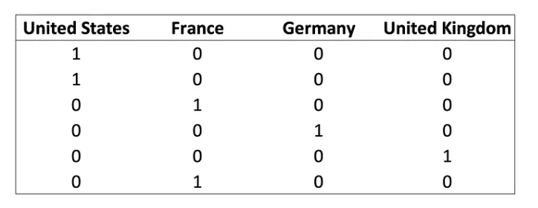
One-Hot Encoding
One-Hot Encoding is the most common, correct way to deal with non-ordinal categorical data.
It consists of creating an additional feature for each group of the categorical feature and mark each observation belonging (Value=1) or not (Value=0) to that group.

Slide 13


